Slide 1

HKBK COLLEGE of ENGINEERING Department of Computer Science and Engineering
HUMAN RESOURCE MANAGEMENT
SYSTEM
By
AasthaGupta-1HK16CS003
FathimaZohra-1HK16CS047
Under the Guidance of
Mrs.Amreen Khanam
Notes:
‹#›

Slide 2
Agenda / Outline
Introduction
System architecture
ER Diagram
Schema diagram
Implementation(Front end, Back end)
*
Department of CSE,HKBKCE

Slide 3
Introduction
It provides the complete information of employees of the organization.
The main objective of the system is to maintain and retrieve information about the
entire personnel framework of the organizational system.
It is a easy management of databases of various sections
covering key aspects.
By entering the details of each employee, we can get all types of reports instantly, which will be useful to call back the information of each employee and performance of each employee.
We can search for all employees,departments, dependent information etc. is possible which can be department wise, level-wise and other parameter based search enabled.
*
Department of CSE,HKBKCE

Slide 4
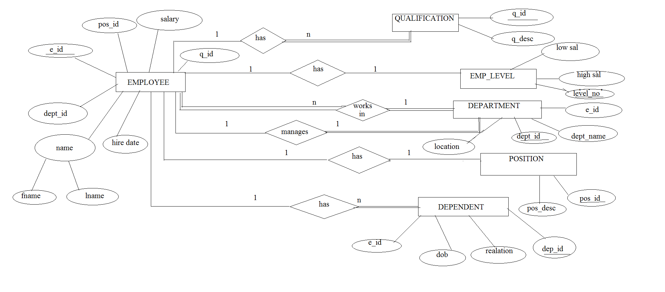
ER Diagram
*
Department of CSE,HKBKCE

Slide 5
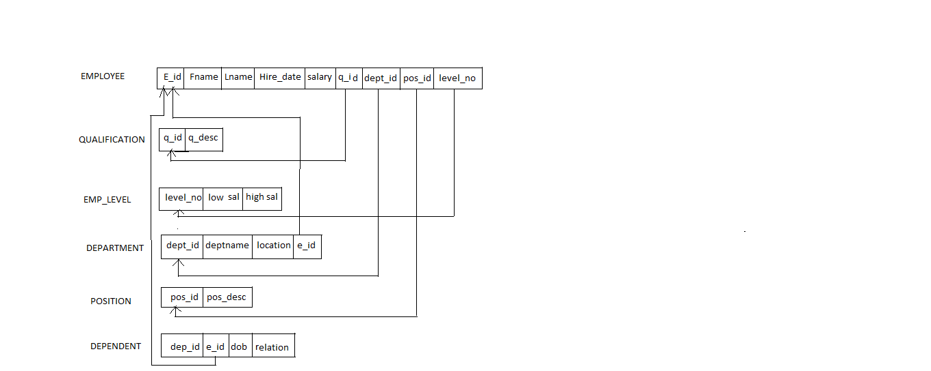
Schema Diagram
*
Department of CSE,HKBKCE

Slide 6
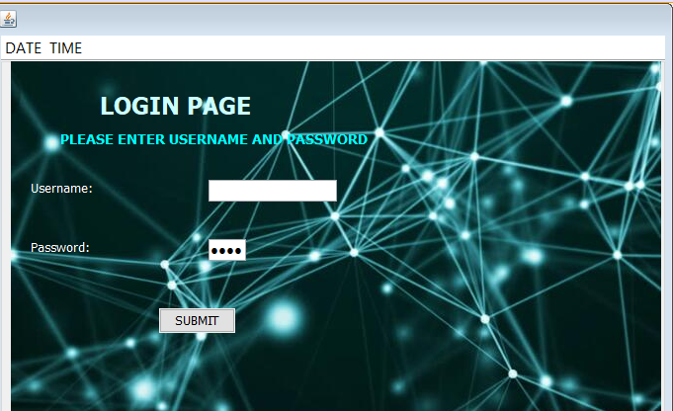
IMPLEMENTATION
login page:
*
Department of CSE,HKBKCE

Slide 7
IMPLEMENTATION
Try{
Connection con=DriverManager.getConnection(‘jdbc:mysql://localhost/employee”,”root”,” ”);
String query =”{CALL ADMIN LOGIN(? ? ?)”:
CallableStatement cs=con .prepared Call(query);
cs.setString(1,Username);
cs.setString(1,password);
cs.registerOutParameter(3,Types.INTEGER);
cs.execute( );
int count =cs.getInt(3);
if(count==1){
JOptionPane.showMessageDialog(null,”login successful!!!”+”\n”+”welcome admin”);
*
Department of CSE,HKBKCE

Slide 8
IMPLEMENTATION
menuif nm=new menuif( );
this.getParent().add(nm);
nm.setVisible(true);
this.setVisible(false);
}
else{
JoptionPane.showmessageDialog(null,”unsuccessful”);
}
}
catch(SQLException ex)
{
Logger.getLogger(login.class.getName()).log(Level.SEVERE,null,ex);
} }
*
Department of CSE,HKBKCE

Slide 9
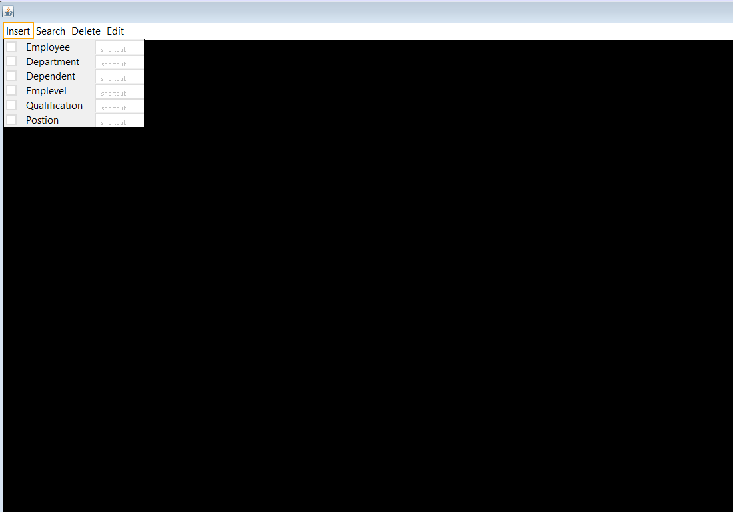
IMPLEMENTATION FOR MAIN MENU
*
Department of CSE,HKBKCE

Slide 10
MAIN MENU
private void jMenu Item1 ActionPerformed(java.awt.event.ActionEvent evt) {
addemployee a=new addemployee();
dp2.add(a);
a.setVisible(true);
}
private void jMenu Item2 ActionPerformed(java.awt.event.ActionEvent evt) {
deptdb d=new deptdb();
dp2.add(d);
d.setVisible(true);
}
private void jMenu Item3 ActionPerformed(java.awt.event.ActionEvent evt) {
DEPENDENT dd=new DEPENDENT();
dp2.add(dd);
dd.setVisible(true); }
*
Department of CSE,HKBKCE

Slide 11
MAIN MENU
private void j Menu Item 4 ActionPerformed(java.awt.event.ActionEvent evt) {
EMPLEVEL el=new EMPLEVEL();
dp2.add(el);
el.setVisible(true); }
private void j Menu Item 5 ActionPerformed(java.awt.event.ActionEvent evt) {
QUALIFICATION q=new QUALIFICATION();
dp2.add(q);
q.setVisible(true); }
private void j Menu Item 6 ActionPerformed(java.awt.event.ActionEvent evt) {
POSITION p=new POSITION();
dp2.add(p);
p.setVisible(true); }
private void j Menu Item 12 ActionPerformed(java.awt.event.ActionEvent evt) {
delete emp de=new delete emp();
dp2.add(de); de.setVisible(true); }
*
Department of CSE,HKBKCE

Slide 12
MAIN MENU
private void j Menu Item 13 ActionPerformed(java.awt.event.ActionEvent evt) {
editemp ee=new editemp();
dp2.add(ee);
ee.setVisible(true);
}
private void j Menu Item 7 Action Performed(java.awt.event.ActionEvent evt) {
searchemp se=new searchemp();
dp2.add(se);
se.setVisible(true);
}

Slide 13
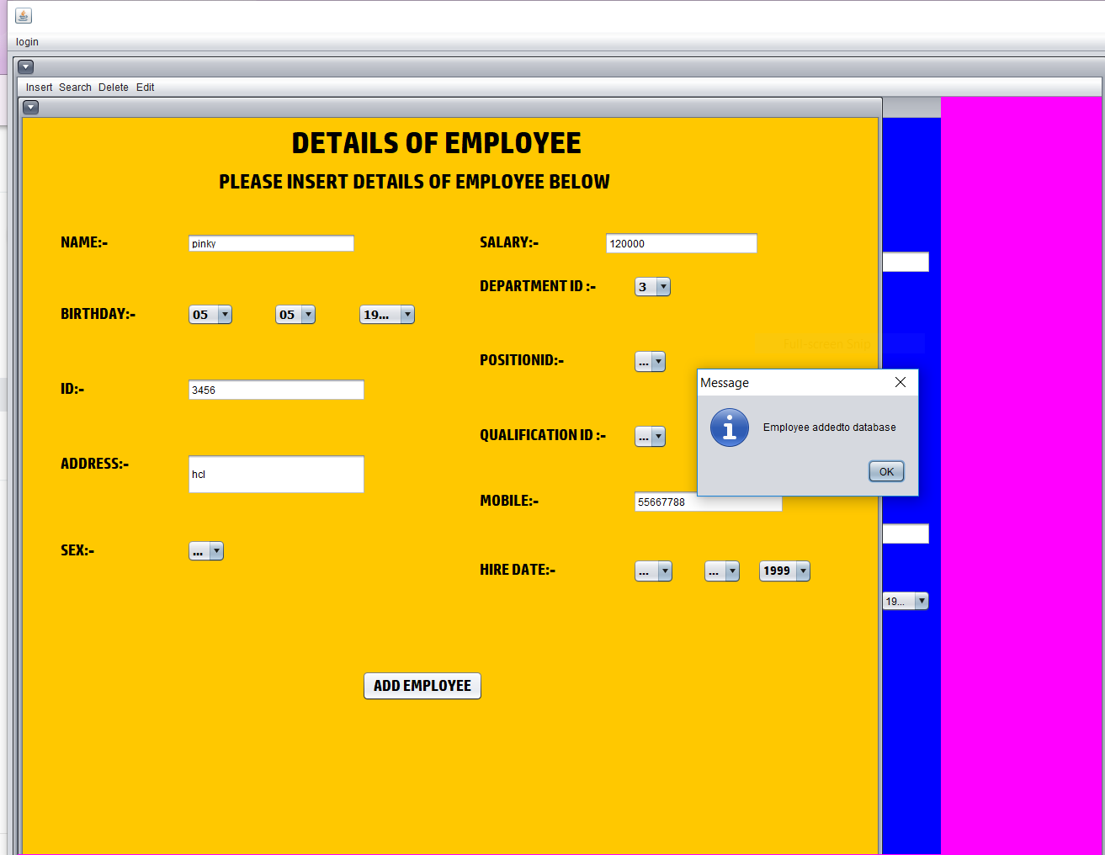
IMPLEMENTATION FOR ADMIN TO INSERT INTO THE DATABASE
*
Department of CSE,HKBKCE

Slide 14
EMPLOYEE PAGE FOR INSERTION
try{
String url="jdbc:derby://localhost:1527/addemployee";
String username="abc";
String password="1234";
Connection conn=DriverManager.getConnection(url,username,password);
Statement stmt=conn.createStatement();
stmt.execute (“insert into addemployee(NAME, BIRTHDAY, BIRTH MONTH,BIRTH YEAR, ID, ADDRESS ,SEX,
SALARY , DEPARTMENT ID,POSITION ID, QUALIFICATION ID, MOBILE, HIREDAY, HIRE MONTH, HIRE
YEAR ) VALUES (“+"+NameText.getText()+"','"+ BirthDay.getSelectedItem()+"','"+ Birth Month.getSelectedItem()+"','"+
Birth Year.getSelectedItem()+"','"+id.getText()+"','"+address.getText()+"','"+"sex.getSelectedItem(+ salary.getText()+"','
'+ department.getSelectedItem()+"','"+ pos.getSelectedItem()+"','"+qualification.getSelectedItem()+"','"+mobile.getText()+"','"+ HireDay.getSelectedItem()+"'
HireMonth.getSelectedItem()+"','"+ HireYear.getSelectedItem()+"')");
*
Department of CSE,HKBKCE

Slide 15
EMPLOYEE PAGE FOR INSERTION
JOptionPane.showMessageDialog(null,"Employee added to database");
NameText.setText(null);
BirthDay.setSelectedItem(00);
Birth Month .setSelectedItem(00);
BirthYear.setSelectedItem(00);
id.setText(null);
address.setText(null);
sex.setSelectedItem(00);
salary.setText(null);
department.setSelectedItem(0);
pos.setSelectedItem(0);
qualification.setSelectedItem(0);
mobile.setText(null);
HireDay.setSelectedItem(00);
HireMonth.setSelectedItem(00); HireYear.setSelectedItem(00); }
*
Department of CSE,HKBKCE

Slide 16
DELETION
private void jButton1ActionPerformed(java.awt.event.ActionEvent evt) {
try{
String url="jdbc:derby://localhost:1527/addemployee";
String username="abc";
String password="1234";
Connection conn=DriverManager.getConnection(url,username,password);
Statement stmt=conn.createStatement();
String Query="delete from addemployee where '"+eid.getText()+"'=id";
stmt.execute(Query);
JOptionPane.showMessageDialog(null,"Employee is deleted from database");
}
*
Department of CSE,HKBKCE

Slide 17
DELETION
catch(SQLException ex )
{
JOptionPane.showMessageDialog(null,ex.toString());
} }
*
Department of CSE,HKBKCE

Slide 18
UPDATE
package hr;
import java.awt.Color;
import java.sql.*;
import javax.swing.*;
import javax.swing.text.Position
private void jButton1ActionPerformed(java.awt.event.ActionEvent evt) {
// TODO add your handling code here:
int result= List1.getNextMatch(SearchText.getText(),0, Position.Bias.Forward);
List1.setSelectedIndex(result);
}
*
Department of CSE,HKBKCE

Slide 19
SEARCH ANY DATA
package hr;
import java.awt.Color;
import java.sql.*;
import javax.swing.*;
import javax.swing.text.Position;
private void jButton1ActionPerformed(java.awt.event.ActionEvent evt) {
// TODO add your handling code here:
int result= List1.getNextMatch(SearchText.getText(),0, Position.Bias.Forward);
List1.setSelectedIndex(result);
}
*
Department of CSE,HKBKCE

Slide 20
THANK YOU !!!
*
Department of CSE,HKBKCE

